Slide 1


BCSE307L – Compiler Design
Module 5 – Code Optimization

Slide 2
Code Optimization
The code optimization in the synthesis phase is a program transformation technique, which tries to improve the intermediate code by making it consume fewer resources (i.e. CPU, Memory) so that faster-running machine code will result.
The compiler optimizing process should meet the following objectives :
The optimization must be correct, it must not, in any way, change the meaning of the program.
Optimization should increase the speed and performance of the program.
The compilation time must be kept reasonable.
The optimization process should not delay the overall compiling process.

Slide 3
Code Optimization
Front End
Intermediate Code
Code Generator
Target Program
Compiler can optimize
User can optimize

Slide 4
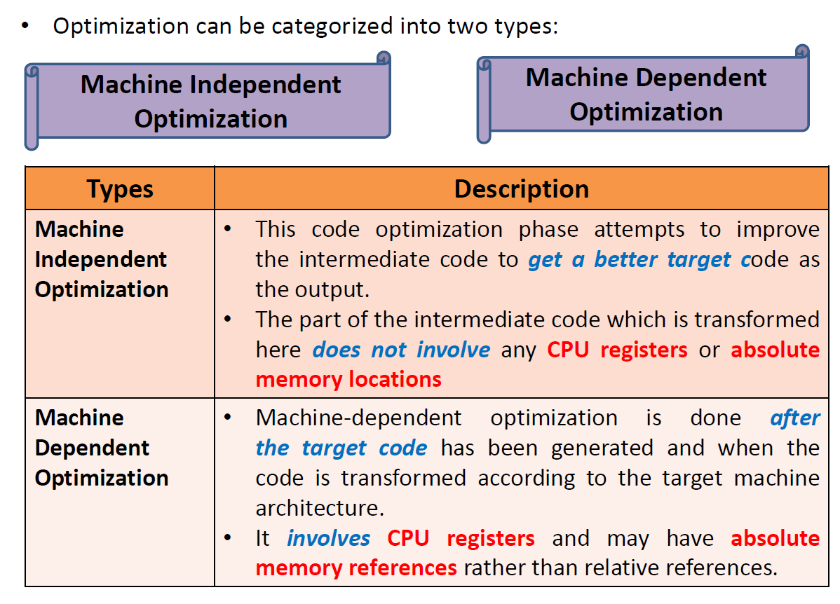
Code Optimization

Slide 5
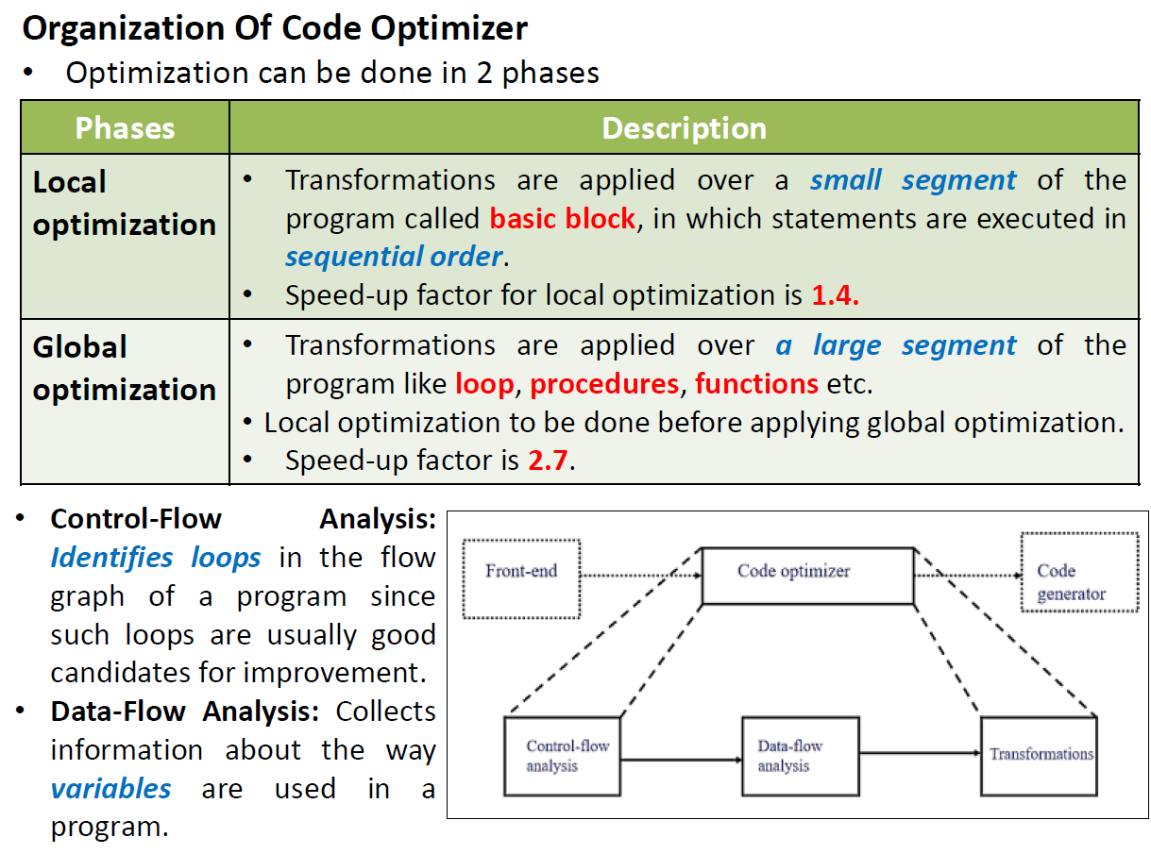

Slide 6
Compile time evaluation
Compile time evaluation means shifting of computations from run time to compile time.
There are two methods used to obtain the compile time evaluation.
1. Folding
In the folding technique the computation of constant is done at compile time instead of run time.
Example : length = (22/7)*d
Folding is implied by performing the computation of 22/7 at compile time.

Slide 7
Cont.,
2. Constant/ Variable propagation
In this technique the value of variable is replaced and computation of an expression is done at compilation time.
Example : pi = 3.14; r = 5;
Area = pi * r * r;
At the compilation time the value of pi is replaced by 3.14 and r by 5 then computation of 3.14 * 5 * 5 is done during compilation.

Slide 8
Principal Sources of Optimization

Slide 9
Principal Sources of Optimization
Common sub expressions elimination
Dead code elimination
Code Motion
Copy Propagation
Induction variable elimination & Reduction in Strength
Constant folding
Induction Variable elimination

Slide 10
1. Common sub expressions elimination
The common sub expression is an expression appearing repeatedly in the program which is computed previously.
If the operands of this sub expression do not get changed at all then result of such sub expression is used instead of re-computing it each time.
Example:
a=b+c
b=a-d
c=b+c
d=a-d
a=b+c
b=a-d
c=b+c
d=b
t1 := 4 * i
t2 := a[t1]
t3 := 4*j
t4 : = 4 * i
t5:= n
t6 := b[t4]+t5

Slide 11
2. Dead code elimination
The variable is said to be dead at a point in a program if the value contained into it is never been used.
The code containing such a variable supposed to be a dead code.
Example:
i=0;
if(i==1)
{
a=x+5;
}
If statement is a dead code as this condition will never get satisfied hence, statement can be eliminated and optimization can be done.
Dead Code

Slide 12
3. Code Motion
Optimization can be obtained by moving some amount of code outside the loop and placing it just before entering in the loop.
This method is also called loop invariant computation.
Example:
while(i<=max-1) { sum=sum+a[i]; } |  | N=max-1; while(i<=N) { sum=sum+a[i]; }
a=200;
while(a>0)
{
b=x+y;
if(a%b==0)
printf(“%d”,a);
}
a=200;
b=x+y;
while(a>0)
{
if(a%b==0)
printf(“%d”,a);
}

Slide 13
4. Copy Propagation
Copy propagation means use of one variable instead of another.
Example:
x = pi;
area = x * r * r;
area = pi * r * r;
x=a
y=x*b
z=x*c
x=a
y=a*b
z=a*c

Slide 14
5. Induction variable elimination & Reduction in Strength
Priority of certain operators is higher than others.
For instance strength of * is higher than +.
In this technique the higher strength operators can be replaced by lower strength operators.
Addition of a constant is cheaper than a multiplication. So we can replace multiplication with an addition within the loop.
Multiplication is cheaper than exponentiation. So we can replace exponentiation with multiplication within the loop.
Example:
Here, we get the count values as 7, 14, 21…. and so on.
for(i=1;i<=50;i++) { count = i*7; } |  | temp=7; for(i=1;i<=50;i++) { count = temp; temp = temp+7; }

Slide 15
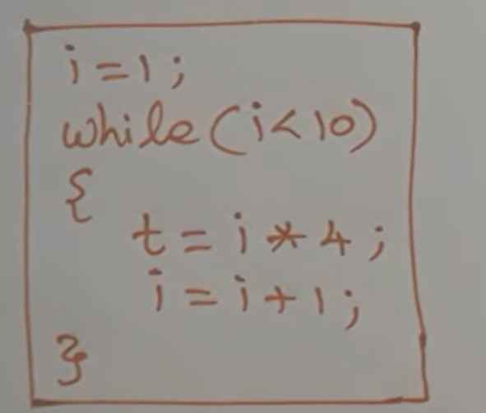
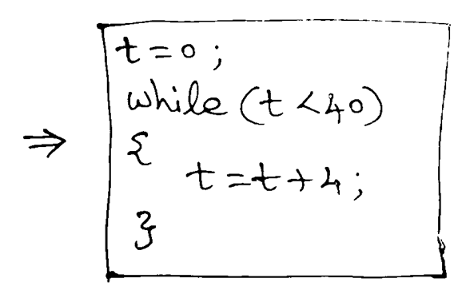
Cont… [Another Example]

Slide 16
6. Constant Folding
If the value of an expression is constant then use constant instead of the expression
Ex: pi = 22/7 ➔ pi = 3.14..

Slide 17
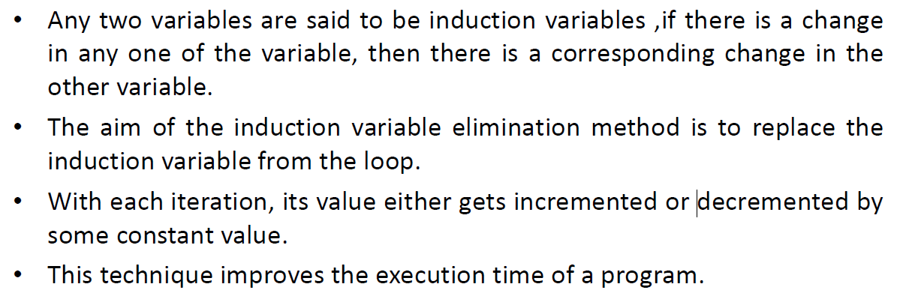
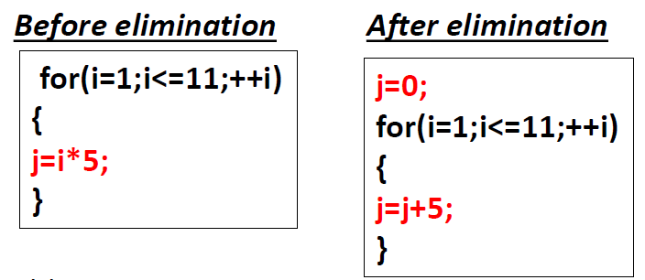
7. Induction Variable elimination

Slide 18
7. Induction Variable elimination

Slide 19
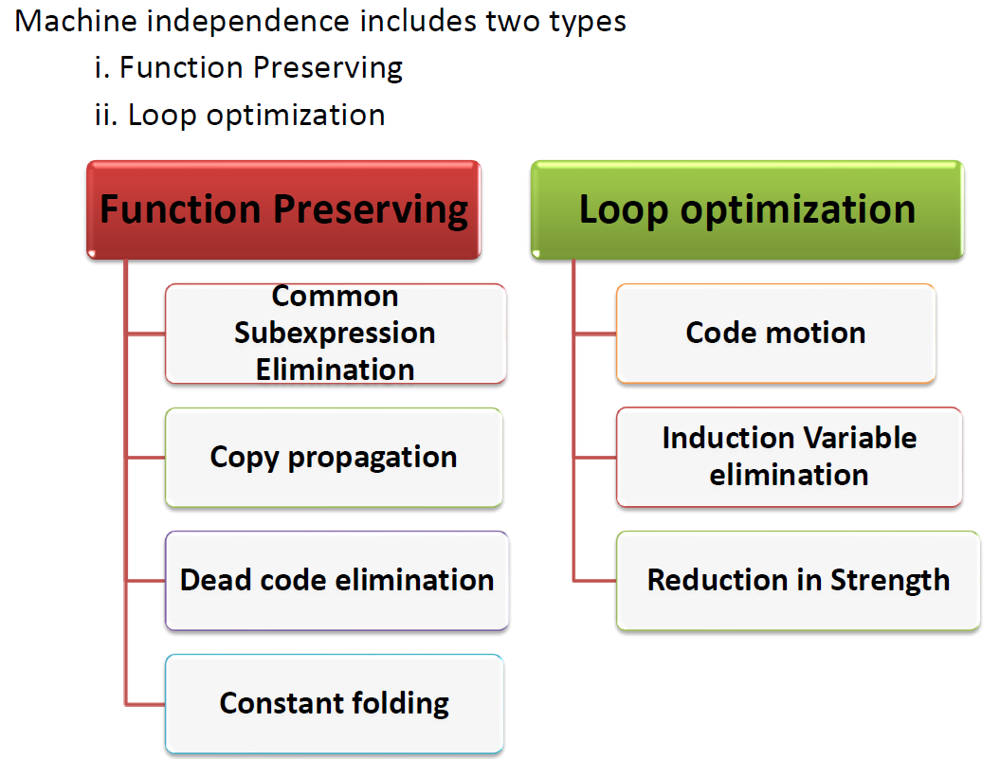
Principal Sources of Optimization - Classification

Slide 20
Global Data Flow Analysis

Slide 21
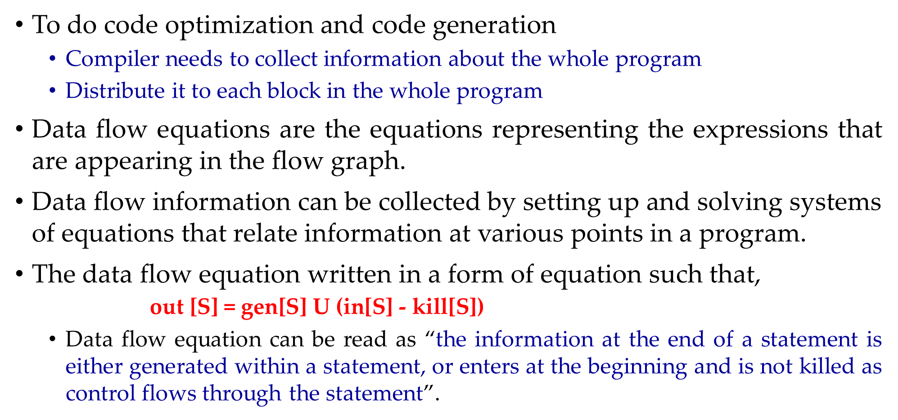
Global Data Flow Analysis
To do code optimization and code generation
Compiler needs to collect information about the whole program
Distribute it to each block in the whole program
Data flow equations are the equations representing the expressions that are appearing in the flow graph.
Data flow information can be collected by setting up and solving systems of equations that relate information at various points in a program.
The data flow equation written in a form of equation such that,
$\text{out}\text{ [}\text{S}\text{] = }\text{gen}\text{[}\text{S}\text{] }\text{U}\text{ (}\text{in}\text{[}\text{S}\text{] −} \text{kill}\text{[}\text{S}\text{])}$
Data flow equation can be read as “the information at the end of a statement is either generated within a statement, or enters at the beginning and is not killed as control flows through the statement”.
Notes:
Data- flow analysis" refers to a body of techniques that derive information about the flow of data along program execution paths. For example, one way to
implement global common subexpression elimination requires us to determine whether two textually identical expressions evaluate to the same value along
any possible execution path of the program. As another example, if the result of an assignment is not used along any subsequent execution path, then we
can eliminate the assignment as dead code.

Slide 22
Data Flow Properties
A program point containing the definition is called Definition point.
A program point at which a reference to a data item is made is called Reference point.
A program point at which some evaluating expression is given is called Evaluation point.
W₁:x=3
Definition point
W₂: y=x
Reference point
W₃: z=a*b
Evaluation point

Slide 23
Path
A path from p₁ to p_{n} is sequence of points p₁, p₂, …p_{n} such that for each i between 1 and n-1, either,
P_{i} – point immediately preceding the statement
P_{i+1} – point immediately following that statement in the same block
P_{i} – End of some block
P_{i+1} – beginning of a successor block

Slide 24
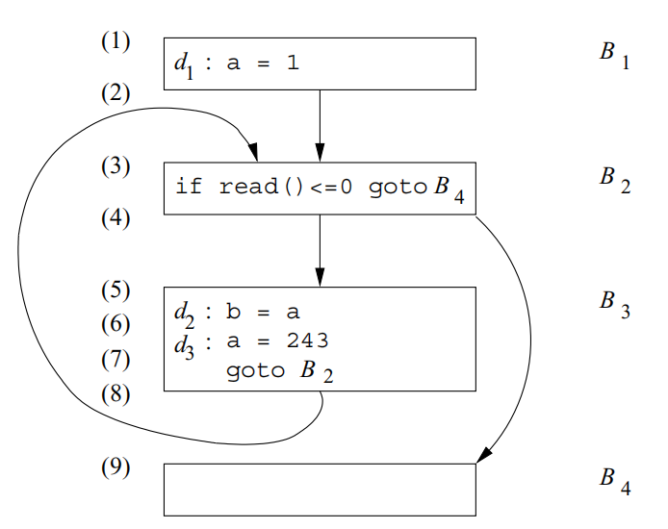
Example program illustrating the dataflow path
(1; 2; 3; 4; 9).
(1; 2; 3; 4; 5; 6; 7; 8; 3; 4;9)

Slide 25
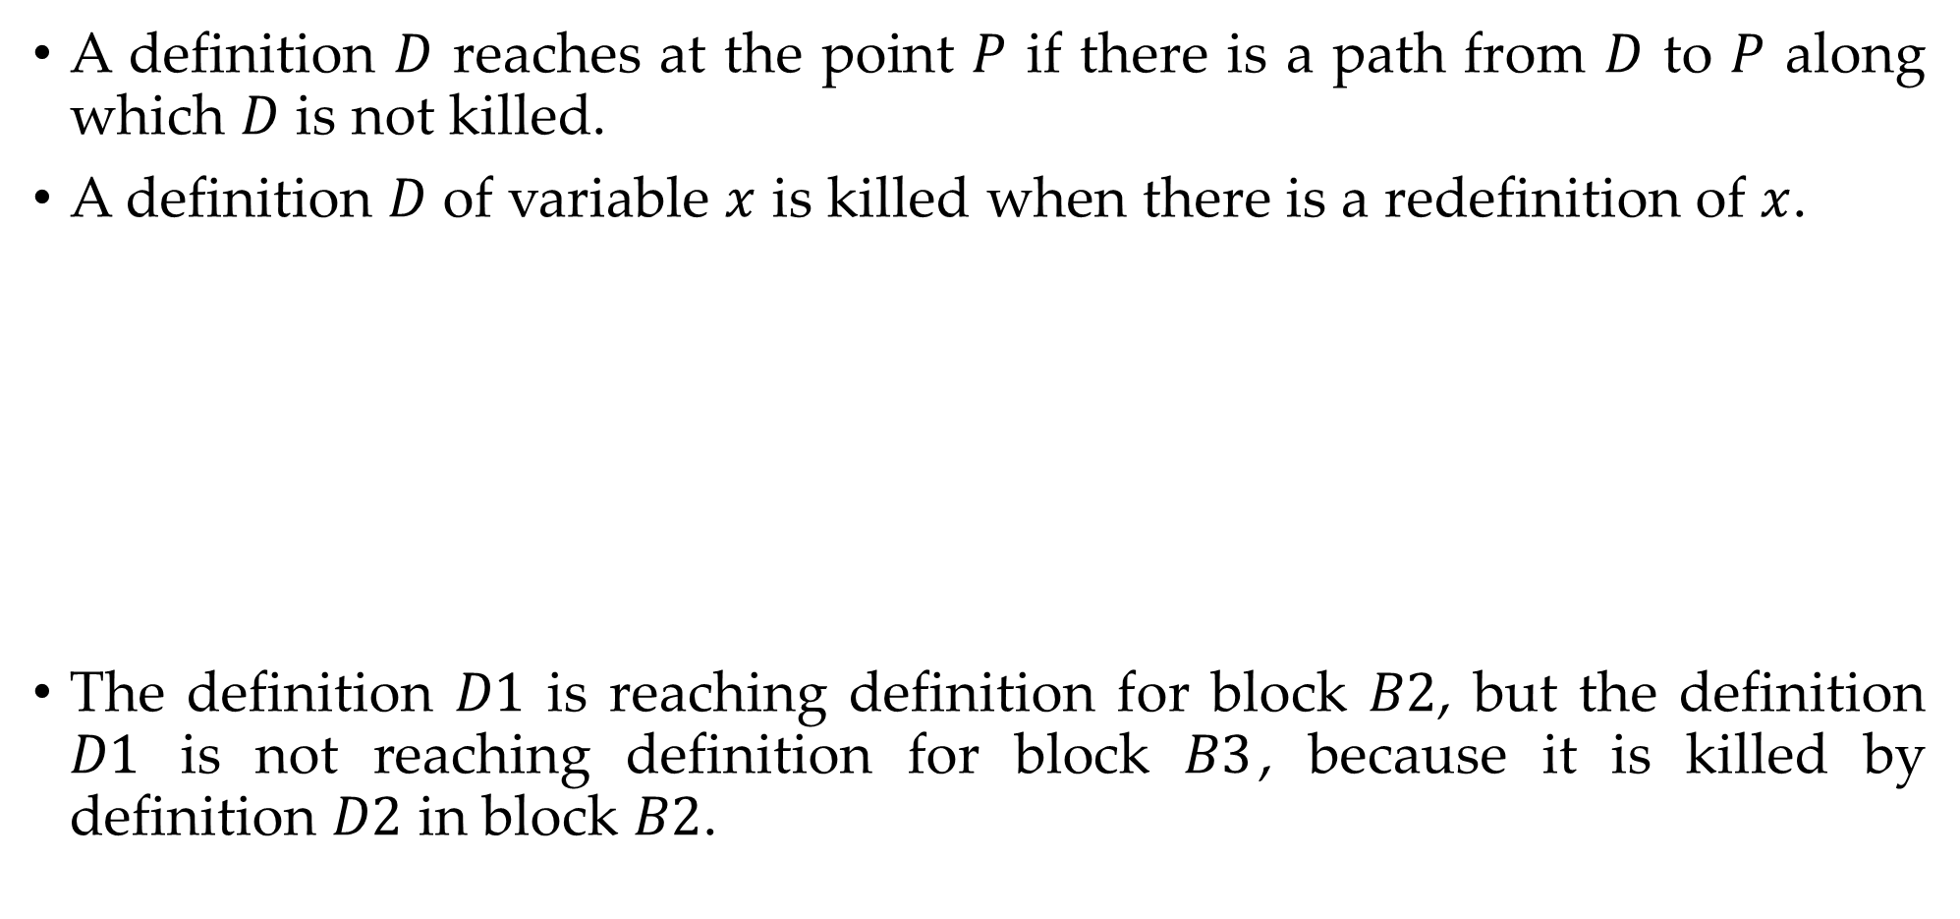
Reaching Definition
A definition $D$ reaches at the point $P$ if there is a path from $D$ to $P$ along which $D$ is not killed.
A definition $D$ of variable $x$ is killed when there is a redefinition of $x$.
The definition $D1$ is reaching definition for block $B2$, but the definition $D1$ is not reaching definition for block $B3$, because it is killed by definition $D2$ in block $B2$.
D1: y=2
B1
D2: y=y+2
B2
D3: x=y+2
B3

Slide 26
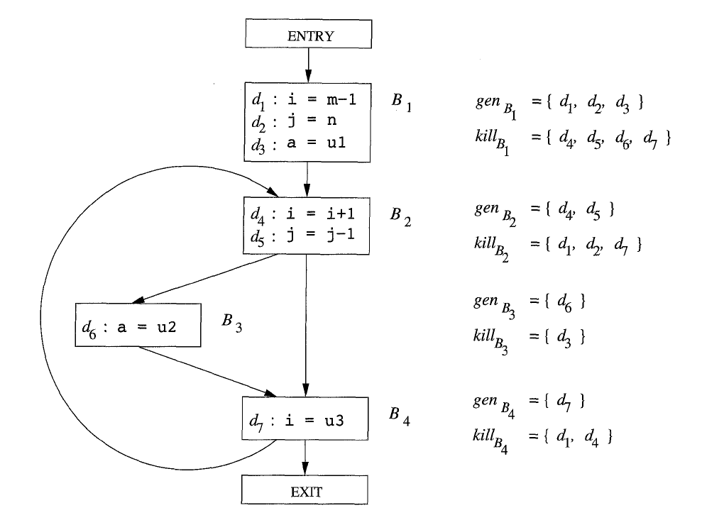

Slide 27

Available Expression
Determines the points in the program where a particular expression is “available”, meaning that its value has already been computed and can be reused.
An expression $x+y$ is available at a program point w if and only if along all paths are reaching to w.
The expression $x+y$ is said to be available at its evaluation point.
Neither of the two operands get modified before their use.
Expression $4 ∗ i$is the available expression for $B2$, $B3$ and $B4$ because this expression has not been changed by any of block appearing before $B4$.
B₁: t₁=4*i
B₂: t₂:c+d[t1]
B₃: t₃=4*i
B₄: t₄=a[t₃]

Slide 28
Example - Computation of available expressions
After the first, b+c is available.
After the second statement, a - d becomes available, but b + c is no longer available because b has been redefined.
The third statement does not make b + c available again, because the value of c is immediately changed.
After the last statement, a - d is no longer available, because d has changed.
Thus no expressions are generated, and all expressions involving a, b, c, or d are killed

Slide 29
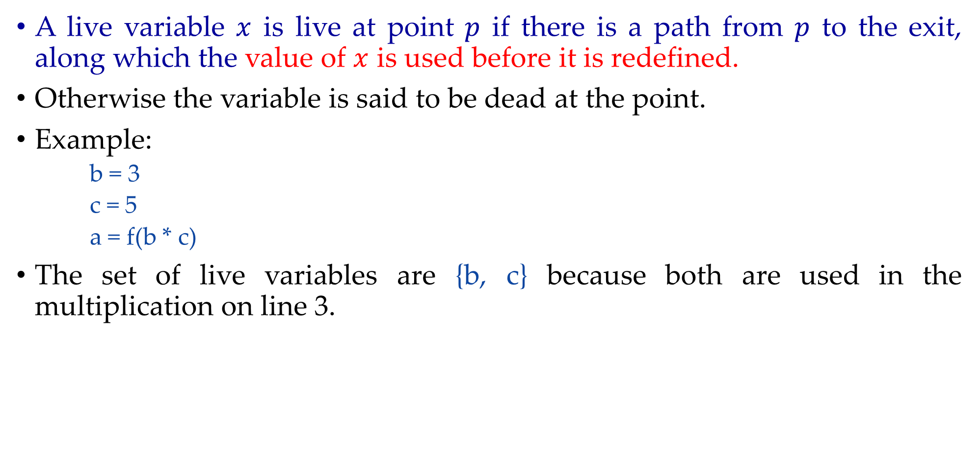
Live variable
A live variable $x$ is live at point $p$ if there is a path from $p$ to the exit, along which the value of $x$ is used before it is redefined.
Otherwise the variable is said to be dead at the point.
Example:
b = 3
c = 5
a = f(b * c)
The set of live variables are {b, c} because both are used in the multiplication on line 3.

Slide 30
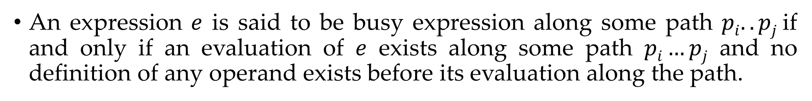
Busy Expression
An expression $e$ is said to be busy expression along some path $pi..pj$if and only if an evaluation of $e$ exists along some path $pi…pj$ and no definition of any operand exists before its evaluation along the path.
Available Expression - It is used to eliminate common subexpressions.
Reaching definition - It is generally used in variable/constant propagation.
Live variable - It is generally used in register allocation and dead code elimination.
Busy expression - It is used for performing code movement optimization.

Slide 31
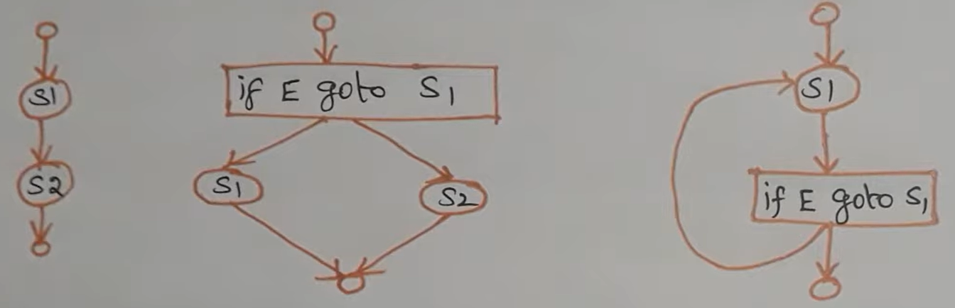
Dataflow analysis of structured programs
S → id:E | S; S | if E then S else S | do S while E
E → id+id | id
Example:

Slide 32
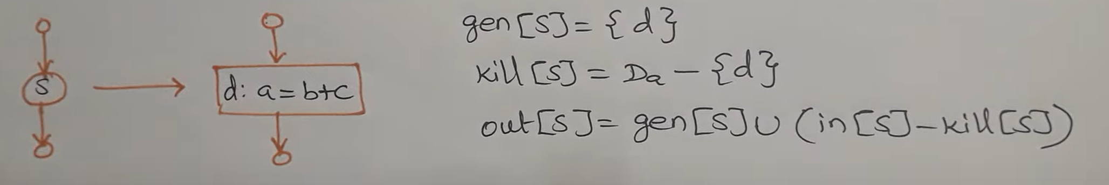
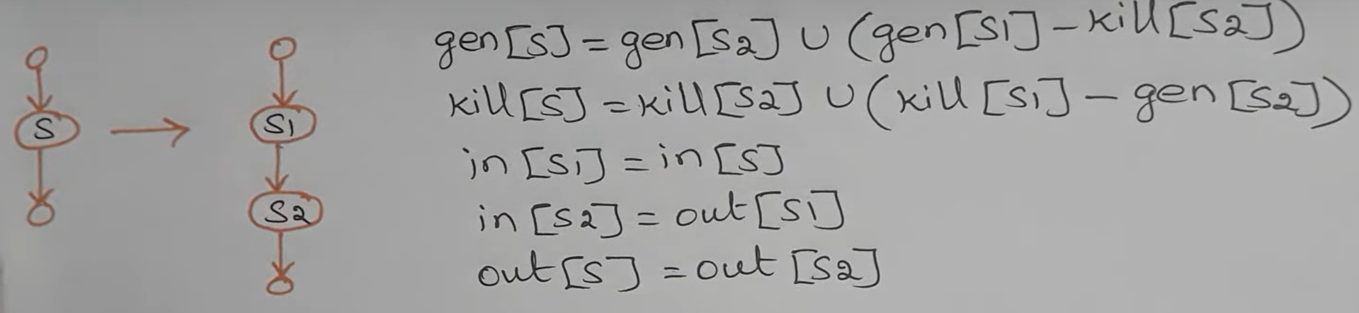
Data flow equations for reaching definitions – [statement(s)]
Single Statement
Newly generated definition, d for a
All previous definition for a will be killed except the newly generated definition, d
Sequence of Statements

Slide 33
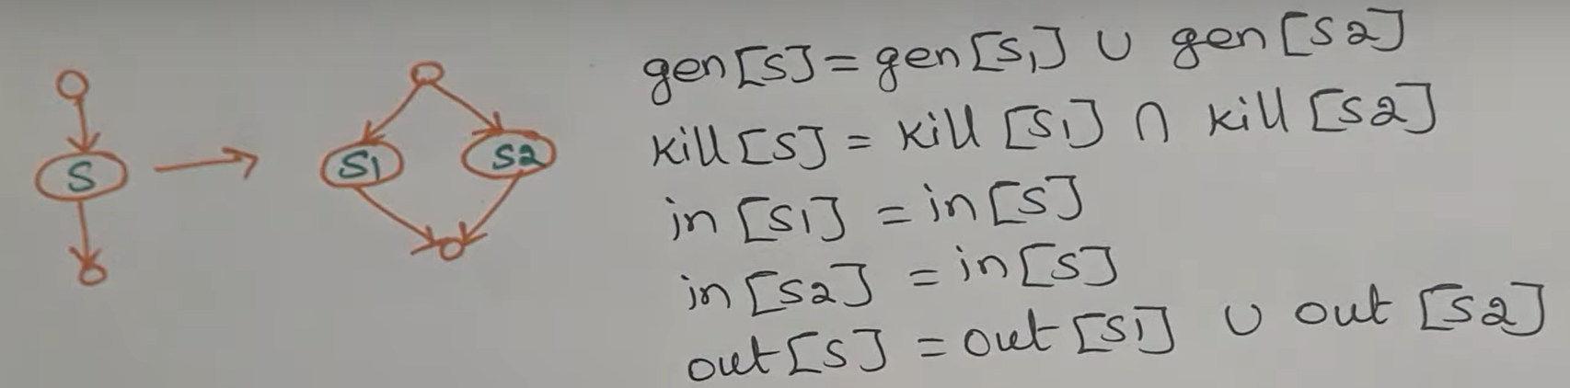
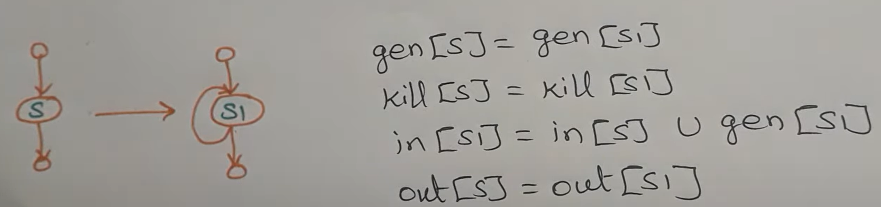
Data flow equations for reaching definitions – [if..else & loop]

Slide 34
Basic Block & Flow Graph

Slide 35
Basic Blocks
A basic block is a sequence of consecutive statements in which flow of control enters at the beginning and leaves at the end without halt or possibility of branching except at the end.
The following sequence of three-address statements forms a basic block:
t1 := a*a
t2 := a*b
t3 := 2*t2
t4 := t1+t3
t5 := b*b
t6 := t4+t5

Slide 36
Algorithm: Partition into basic blocks
Input: A sequence of three-address statements.
Output: A list of basic blocks with each three-address statement in exactly one block.
Method:
We first determine the set of leaders, for that we use the following rules:
The first statement is a leader.
Any statement that is the target of a conditional or unconditional goto is a leader.
Any statement that immediately follows a goto or conditional goto statement is a leader.
2. For each leader, its basic block consists of the leader and all statements up to but not including the next leader or the end of the program.

Slide 37
Example1: Partition into basic blocks
begin
prod := 0;
i := 1;
do
prod := prod + a[t1] * b[t2];
i := i+1;
while i<= 20
end
Block B1
(1) prod := 0
(2) i := 1
(3) t1 := 4*i
(4) t2 := a [t1]
(5) t3 := 4*i
(6) t4 :=b [t3]
(7) t5 := t2*t4
(8) t6 := prod +t5
(9) prod := t6
(10) t7 := i+1
(11) i := t7
(12) if i<=20 goto (3)
Leader
Leader
Block B2
Three Address Code

Slide 38
Flow Graph
We can add flow-of-control information to the set of basic blocks making up a program by constructing a direct graph called a flow graph.
Nodes in the flow graph represent computations, and the edges represent the flow of control.
Example of flow graph for following three address code:
Construction of Flow Graph
Draw directed edge from block1 to block2 if
Conditional or unconditional jump from block1 to block2
Block2 immediately follows block1
Block B1
prod=0
i=1
t1 := 4*i
t2 := a [t1]
t3 := 4*i
t4 :=b [t3]
t5 := t2*t4
t6 := prod +t5
prod := t6
t7 := i+1
i := t7
if i<=20 goto B2
Flow Graph
Block B2

Slide 39
Example2: Partition into basic blocks
Intermediate code
Flow Graph

Slide 40
Example3: Partition into basic blocks
Construct the Basic Blocks for the following statements
I = 1
While (I < 10)
{
a = b[i] + c;
i++;
}
Result = a + c
I = 1
WSTART: if (I < 10) then goto TRUE
goto EXIT
TRUE: T1 = 4*j
T2 = b[T1]
T3 = T2 + c
a = T3
T4 = I + 1
I = T4
goto WSTART
EXIT: T5 = a + c
Result = T4

Slide 41
Example3: Partition into basic blocks
I = 1
WSTART: if (I < 10) then goto TRUE
goto EXIT
TRUE: T1 = 4*j
T2 = b[T1]
T3 = T2 + c
a = T3
T4 = I + 1
I = T4
goto WSTART
EXIT: T5 = a + c
Result = T4
L1: I = 1
L2: if (I < 10) then goto TRUE
L3: goto EXIT
L4: T1 = 4*j
T2 = b[T1]
T3 = T2 + c
a = T3
T4 = I + 1
I = T4
goto WSTART
L5: T5 = a + c
Result = T5

Slide 42
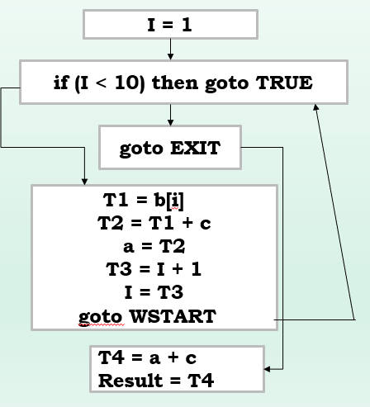
Example3: Partition into basic blocks
L1: I = 1
L2: if (I < 10) then goto TRUE
L3: goto EXIT
L4: T1 = b[i]
T2 = T1 + c
a = T2
T3 = I + 1
I = T3
goto WSTART
L5: T4 = a + c
Result = T4

Slide 43
Transformation on Basic Blocks

Slide 44
Transformation on Basic Blocks
A number of transformations can be applied to a basic block without changing the set of expressions computed by the block.
Many of these transformations are useful for improving the quality of the code.
Types of transformations are:
Structure preserving transformation
Algebraic transformation

Slide 45
I. Structure Preserving Transformations
Structure-preserving transformations on basic blocks are:
Common sub-expression elimination
Dead-code elimination
Renaming of temporary variables
Interchange of two independent adjacent statements

Slide 46
1. Common sub-expression elimination
Consider the basic block,
a:= b+c
b:= a-d
c:= b+c
d:= a-d
The second and fourth statements compute the same expression, hence this basic block may be transformed into the equivalent block:
a:= b+c
b:= a-d
c:= b+c
d:= b

Slide 47
2. Dead-code elimination
It is possible that a program contains a large amount of dead code.
This can be caused when once declared and defined once and forget to remove them in this case they serve no purpose.
Suppose the statement x:= y + z appears in a block and x is dead symbol that means it will never subsequently used. Then without changing the value of the basic block you can safely remove this statement.

Slide 48
3. Renaming of temporary variables
Suppose we have a statement
t:=b+c, where t is a temporary variable.
If we change this statement to
u:= b+c, where u is a new temporary variable,
Change all uses of this instance of t to u, then the value of the basic block is not changed.
In fact, we can always transform a basic block into an equivalent block in which each statement defines a new temporary.
We call such a basic block a normal-form block.

Slide 49
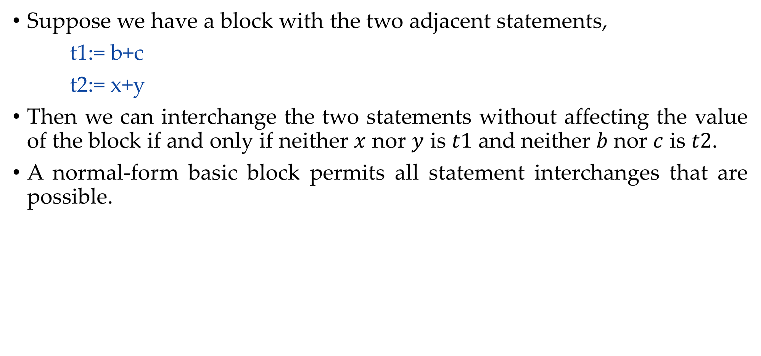
4. Interchange of two independent adjacent statements
Suppose we have a block with the two adjacent statements,
t1:= b+c
t2:= x+y
Then we can interchange the two statements without affecting the value of the block if and only if neither $x$ nor $y$ is $t1$ and neither $b$nor $c$ is $t2$.
A normal-form basic block permits all statement interchanges that are possible.

Slide 50
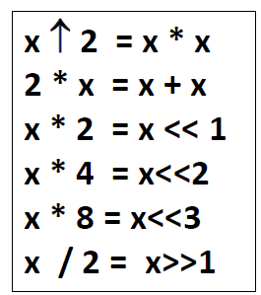
II. Algebraic Transformation
Countless algebraic transformation can be used to change the set of expressions computed by the basic block into an algebraically equivalent set.
The useful ones are those that simplify expressions or replace expensive operations by cheaper one.
Example: x=x+0 or x=x*1 can be eliminated.

Slide 51
Peephole Optimization

Slide 52
Peephole optimization
Peephole optimization is a simple and effective technique for locally improving target code.
Replaces short sequences of target instructions (PEEPHOLE) by a shorter or faster sequence.
It is applied to improve the performance of the target program
Peephole is a small, moving window on the target program.

Slide 53
Techniques of peephole optimization
Redundant Loads & Stores
Unreachable code elimination
Flow of Control Optimization
Algebraic simplification
Use of Machine idioms

Slide 54
Redundant Loads & Stores
Especially the redundant loads and stores can be eliminated in following type of transformations.
Example:
MOV R₀,x
MOV x,R₀
We can eliminate the second instruction since x is in already R₀.

Slide 55
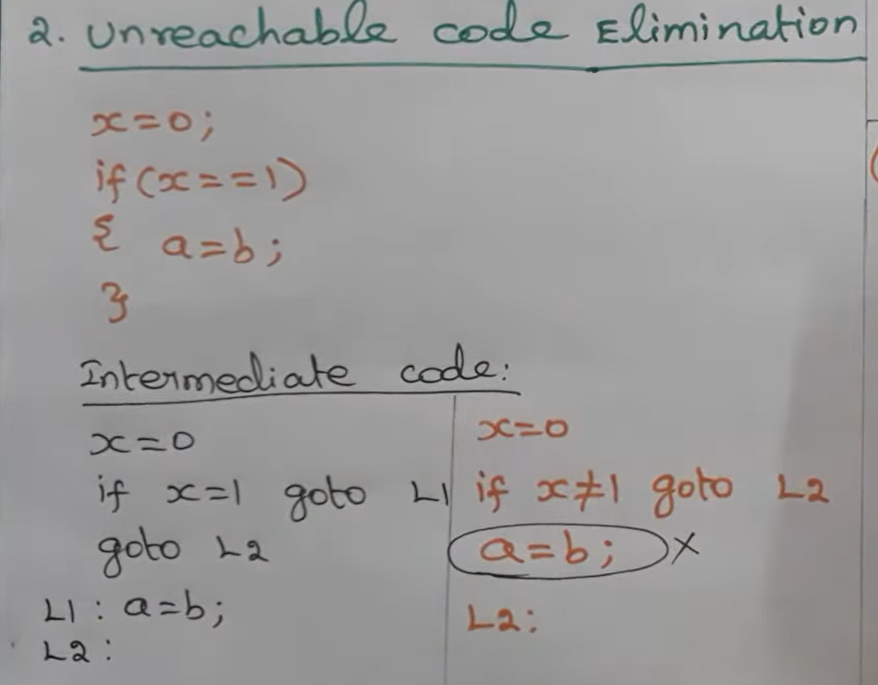
2. Unreachable code elimination

Slide 56
3. Flow of Control Optimization
The unnecessary jumps can be eliminated in either the intermediate code or the target code by the following types of peephole optimizations.
We can replace the jump sequence.
It may be possible to eliminate the statement L1: goto L2 provided it is preceded by an unconditional jump. Similarly, the sequence can be replaced by:
Goto L1 …… L1: goto L2 |  | Goto L2
If a<b goto L1 …… L1: goto L2 |  | If a<b goto L2

Slide 57
4. Algebraic simplification
Peephole optimization is an effective technique for algebraic simplification.
The statements such as x = x + 0 or x := x* 1 can be eliminated by peephole optimization.
Reduction in strength
Certain machine instructions are cheaper than the other.
In order to improve performance of the intermediate code we can replace these instructions by equivalent cheaper instruction.
For example, x * x is cheaper than x^2, x + x is cheaper than 2 * x, x << 1 is cheaper than x * 2, x >> 1 is cheaper than x/2
Similarly addition and subtraction are cheaper than multiplication and division. So we can add effectively equivalent addition and subtraction for multiplication and division.

Slide 58
5. Use of Machine idioms
The target instructions have equivalent machine instructions for performing some operations.
We can replace these target instructions by equivalent machine instructions in order to improve the efficiency.
Example: Some machines have auto-increment or auto-decrement addressing modes.
These modes can be used in code for statement like i=i+1 → INCR i
i=i-1 → DECR i

